Slide 1




BY NURIA QUINTERO
CLIENT:LUCIA - BARCELONA ACTIVA
JUNE 2024
ID 96
Report

Slide 2

BY NURIA QUINTERO
APRIL 2022
01.
Dashboard ID 96
02.
Customer Key Figures
03.
Our Goals

Slide 3
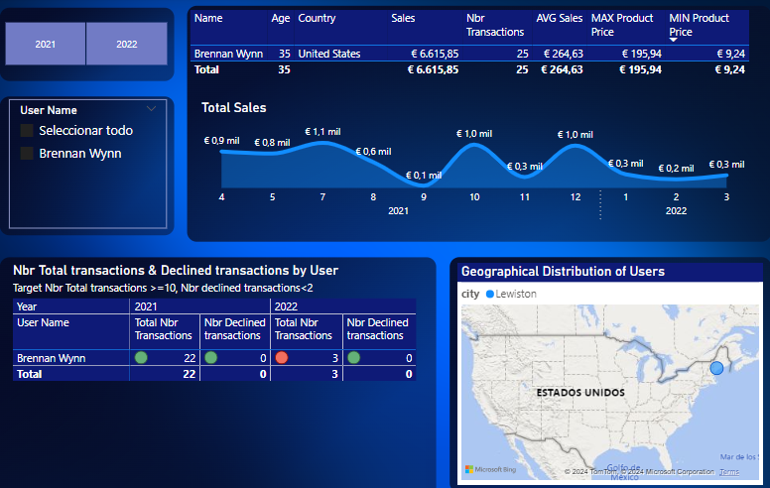
BY NURIA QUINTERO
APRIL 2022
Dashboard ID 96

Slide 4



BY NURIA QUINTERO
APRIL 2022
Customer Key Figures
2021-2022 Statistics
01.
Name: Brennan Wynn
04.
Total Sales: €6.615,85
AVG Sale: €264.63
02.
Age: 35
05.
25 transactions
03.
Country: United States
06.
MAX Product: €195.94 MIN Product: €9.24

Slide 5
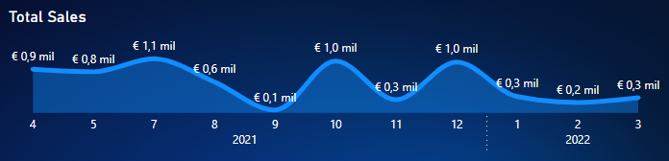
BY NURIA QUINTERO
APRIL 2022
Monthly Sales
Statistics
01.
Top Months
02.
Bottom Months
July, October & December 2021
September, November 2021 & full 2022

Slide 6
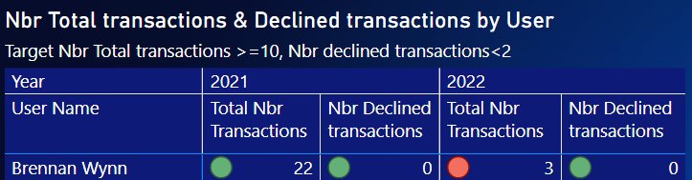
BY NURIA QUINTERO
APRIL 2022
Transactions
Statistics
01.
Total Nbr Transactions
02.
Declined Transactions
22+3 =25
0

Slide 7
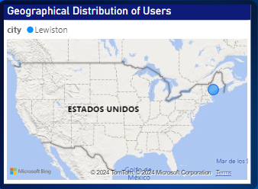
BY NURIA QUINTERO
APRIL 2022
Geographical location
01.
Lewiston
United States

Slide 8

BY NURIA QUINTERO
APRIL 2022
Our Goals
For Q2 2022

Slide 9

BY NURIA QUINTERO
APRIL 2022
Our Goals
Our Top Priorities for The Next Few Months
01.
Increasing Organic Sales
02.
Offering Products aligned with his interest
Sending Newsletters more often
Creating More Valuable Products
03.
Increasing
AVG ticket price
Focus in Cross-Selling

Slide 10




BY NURIA QUINTERO
APRIL 2022
That's It!
Have Any Questions?
Let's Keep in Touch
@nuriaquintero
nuriaquintero.com
info@nuriaquintero.com
677-797-128

